Slide 1
Business Intelligence(BI)

Slide 2
Objectives
What is Business Intelligence?
Need of Business Intelligence
Term used in Business Intelligence
Components of Business Intelligence

Slide 3
What is Business Intelligence
The term was coined by Gartner group in 1993
It is an important component in today’s business information system environment
Business Intelligence (BI) is the process of getting useful information from data.
Turns data into Knowledge and Knowledge into business gain.
Collects and stores data into meaningful information in order to achieve better and timelier business decision.

Slide 4
Need of BI
BI is important in helping organizations to stay ahead of the competition by providing the means for quicker, more accurate,and more informed decision making.
BI helps us to get the result of such questions:
What are my customers and what product are they buying?
What product promotions have biggest impact on revenue?
What are our lowest/highest margin customers?
Which customers are most likely to go the competitions?

Slide 5
Why Business Intelligence ?
Data analysis is a huge and crucial part of Business Intelligence.
Many organization need to know the overall performance and the way its business is functioning.
BI is used to gather present and past data.
Modern BI systems are capable of managing large amount of unstructured data.

Slide 6
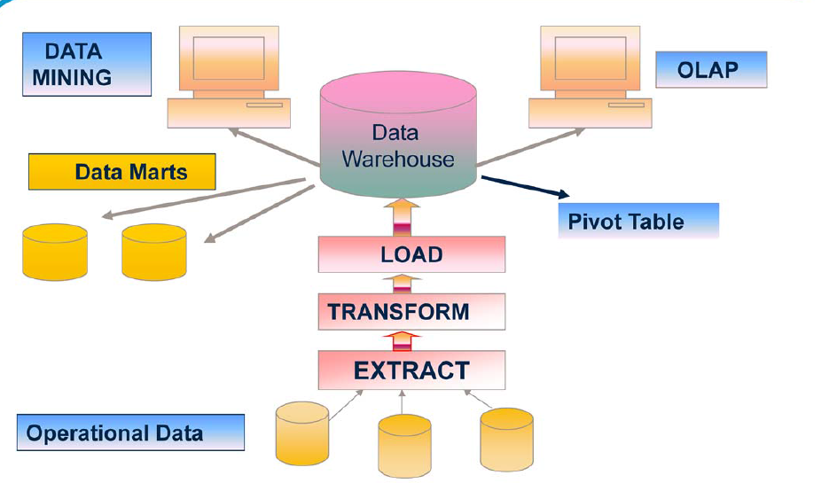
Components of BI

